Slide 1
Cockpit Framework
Module - 11

Slide 2
Contents
Theoretical Background
Layout Configuration

Slide 3
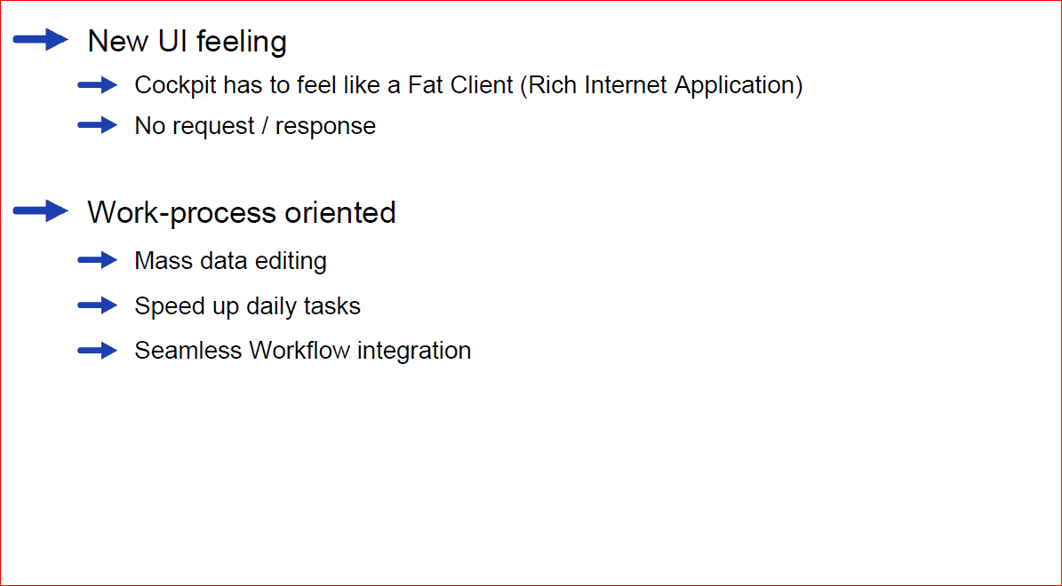
hybris Cockpits – Basic Ideas and Motivations

Slide 4
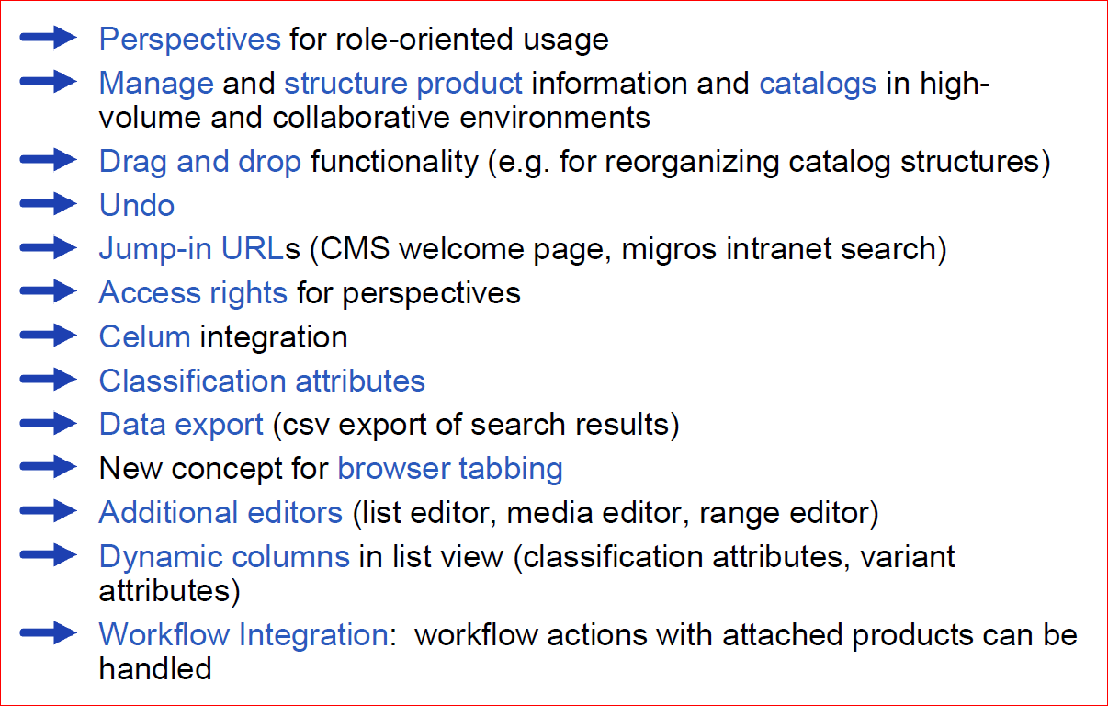
hybris Cockpits – Key Facts

Slide 5
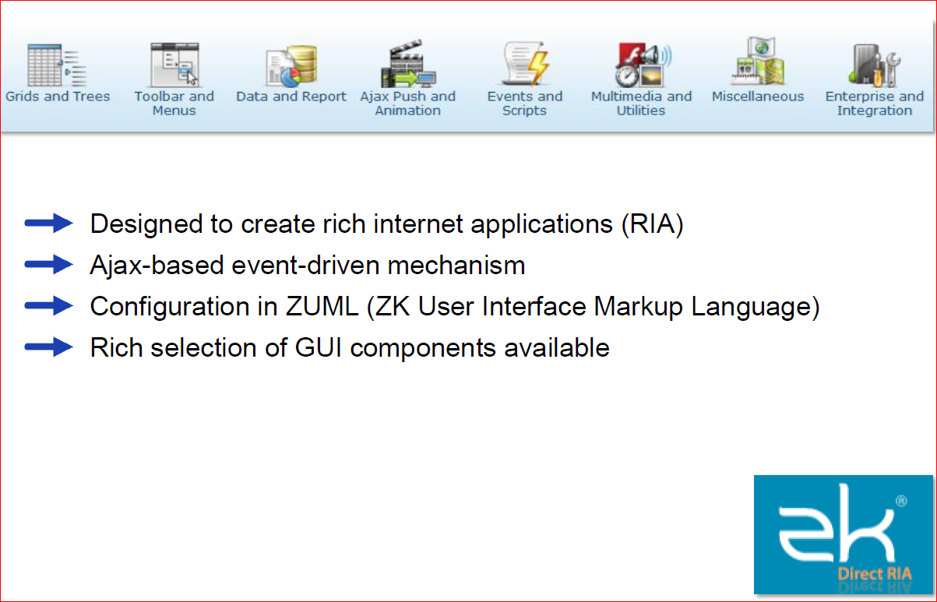
hybris Cockpits – Using Standards

Slide 6
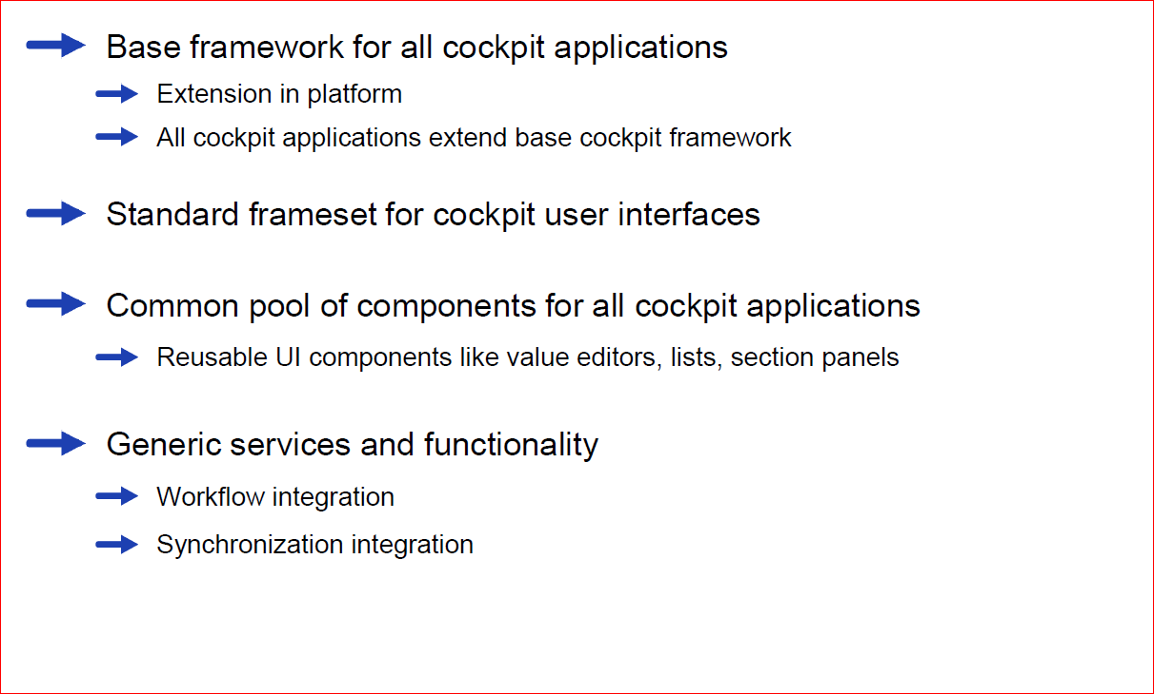
hybris Cockpits – Technical Key Facts

Slide 7
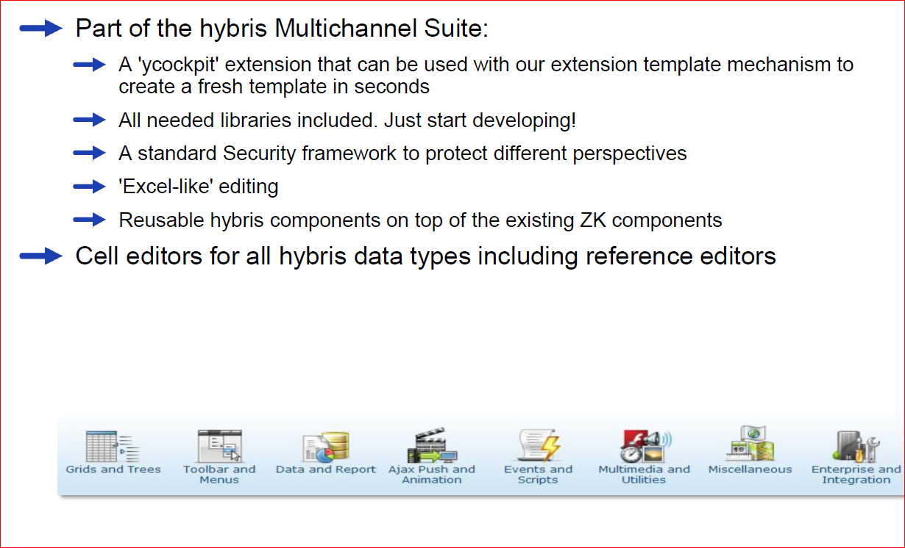
hybris Cockpits – Creating a Custom Cockpit

Slide 8
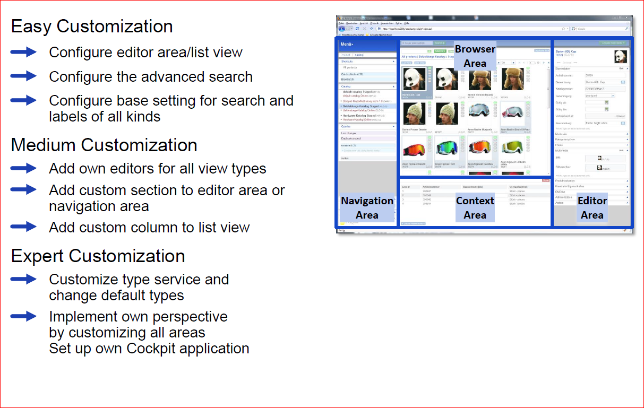
hybris Cockpits – Levels of Customization Complexity

Slide 9
Contents
Theoretical Background
Layout Configuration

Slide 10
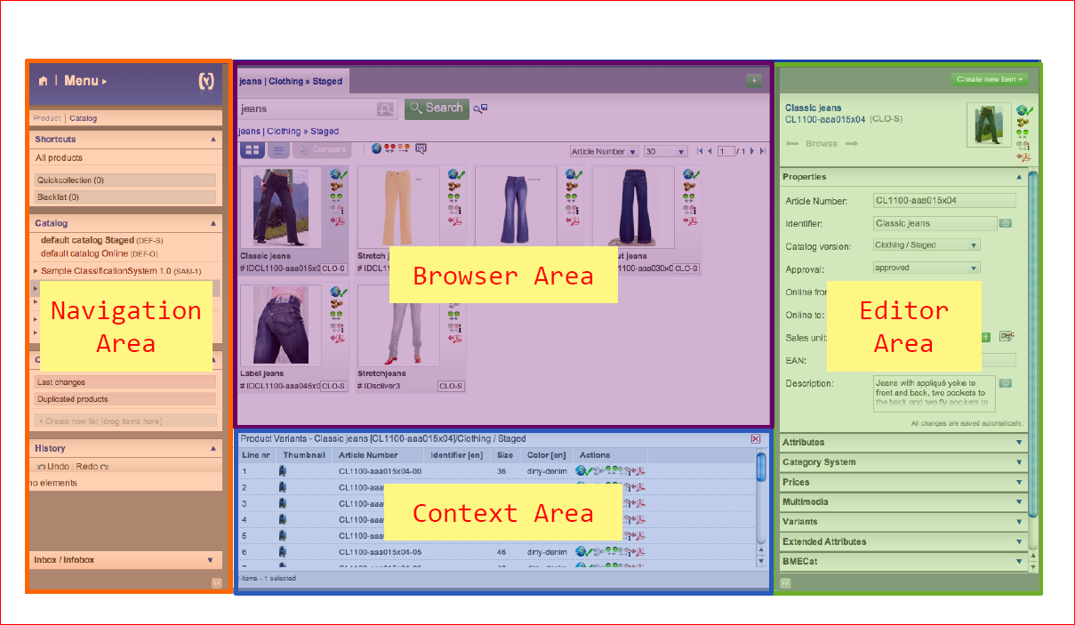
Editable And Customizable

Slide 11
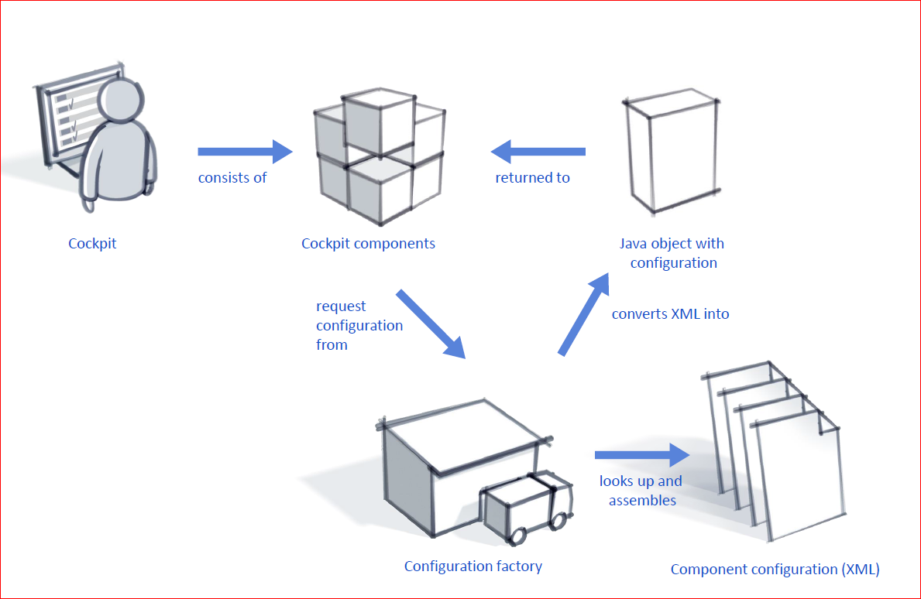
Configuration Schema

Slide 12
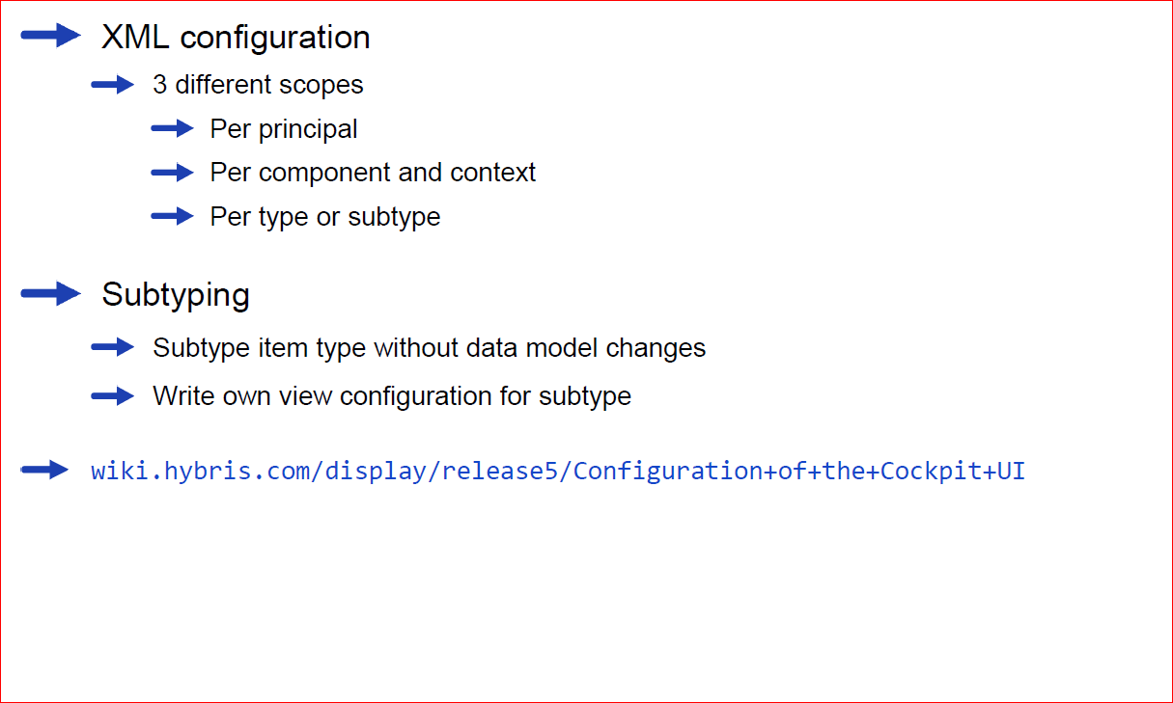
Overview

Slide 13
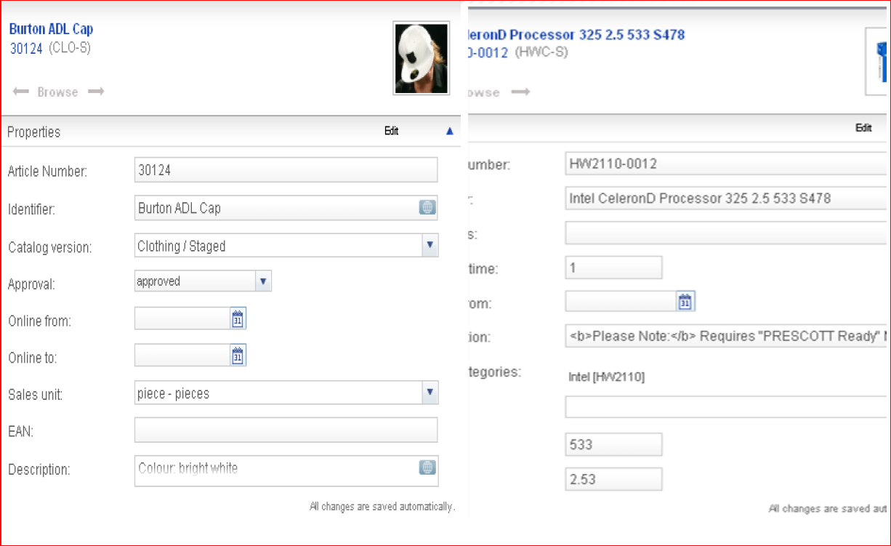
Different View Configurations for the Same Item Type

Slide 14
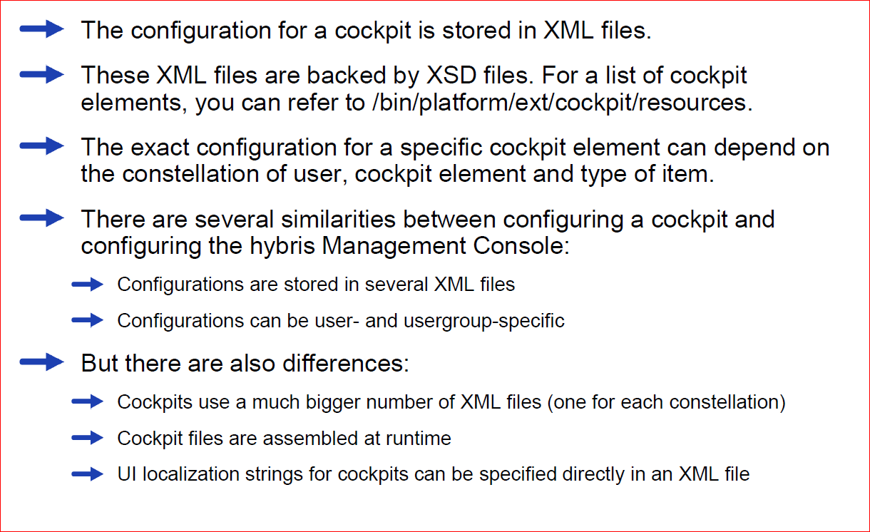
Configuration Details

Slide 15
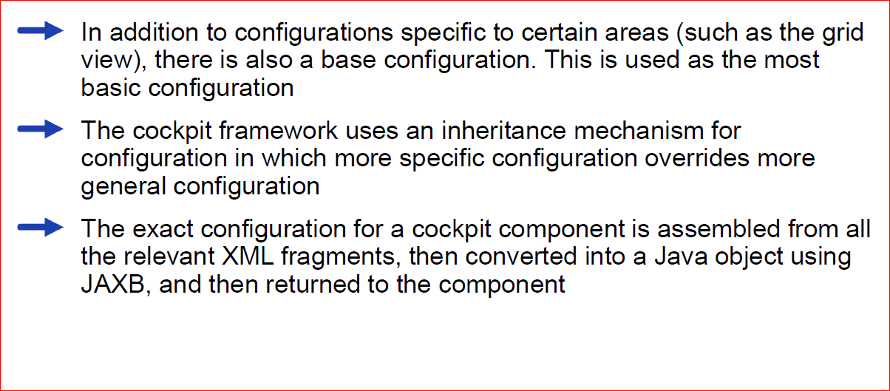
Configuration Details (2)

Slide 16
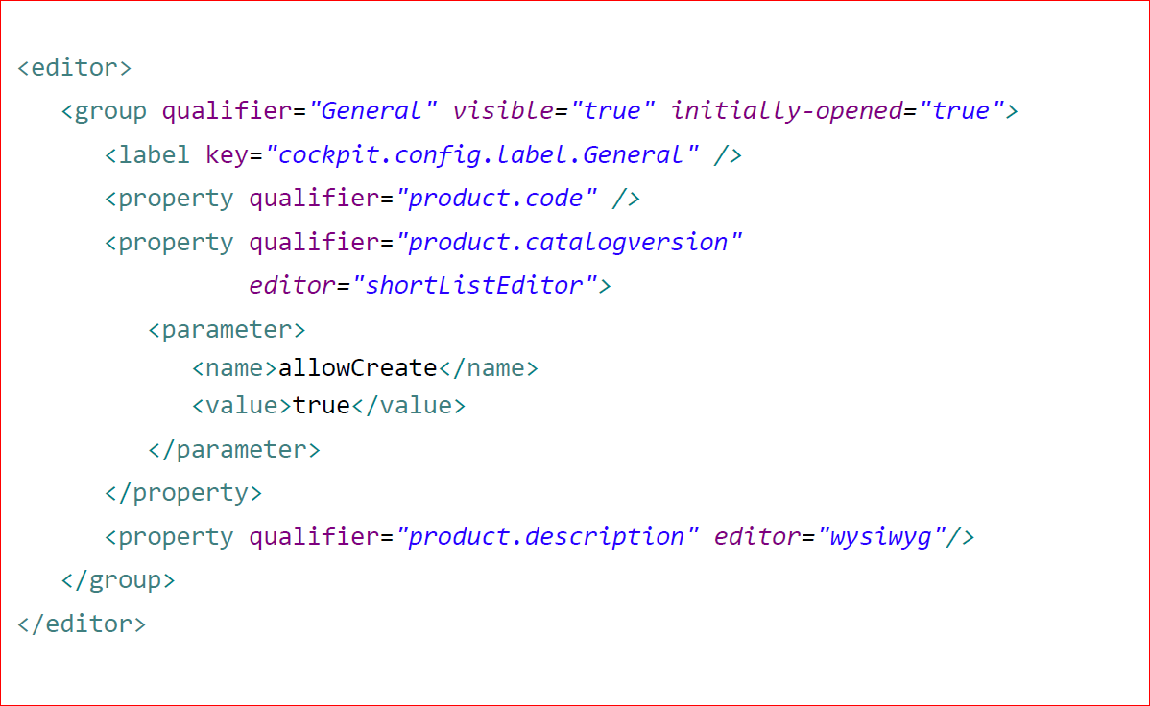
Example of Editor Area

Slide 17
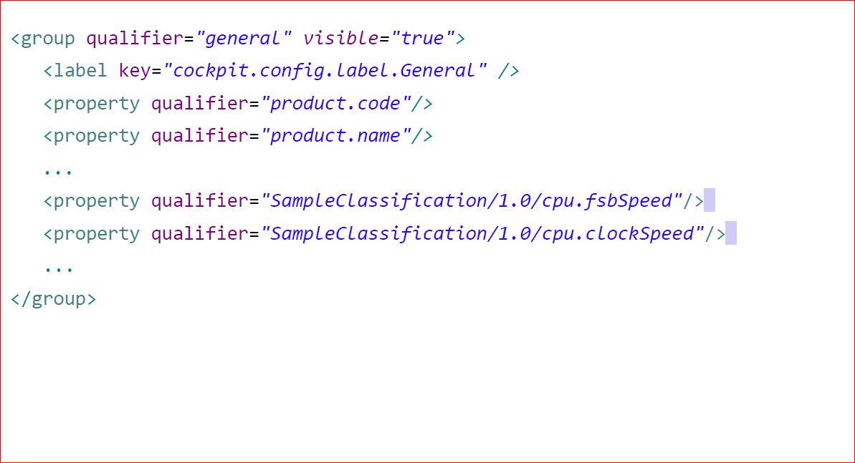
Accessing Classification Attributes

Slide 18
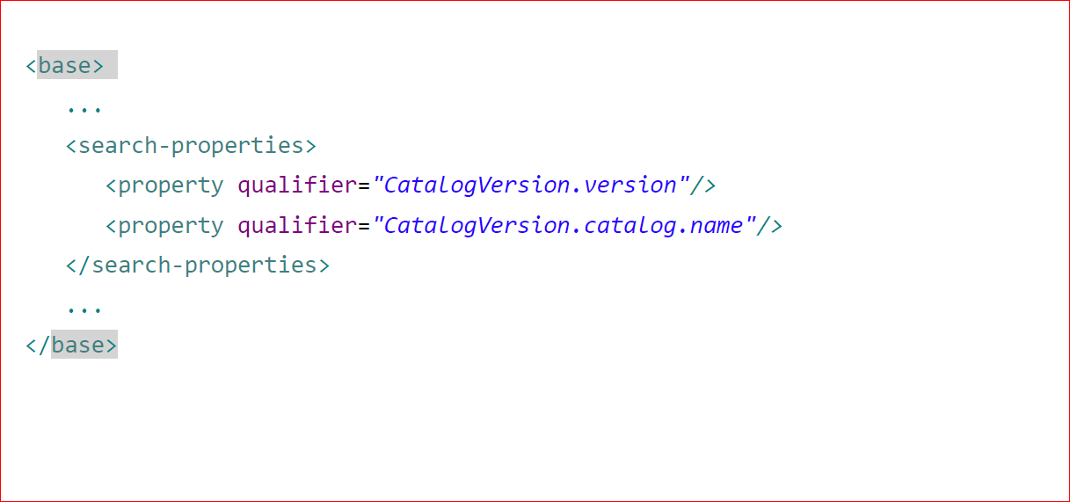
Using Properties of Referenced Types

